Slide 1

EGA:
Accelerating the Deployment of
Grids in Enterprise Data Centers
1
Notes:
1

Slide 2

Agenda
EGA overview
Reference Model and Use Cases
Security Requirements
Data Provisioning Problem Statement and Approach
Going Forward????

Slide 3
The Enterprise Grid Alliance
Launched in April 2004
A consortium of leading vendors and customers
Focused on removing the barriers to enterprise grid adoption
Open, independent, vendor-neutral
Accelerating the Deployment of Grids in
Enterprise Data Centers

Slide 4
EGA objectives
An open grid environment with standards and interoperability specifications
  Endorse and support existing specifications
  Define new specifications where needed
  Mechanisms for testing interoperability
  Test and certification procedures and compliance programs
Practical, achievable near term benefits
  Allow enterprise users to realize near term benefits of grid
Enable rapid adoption of technology advances
  Work with other industry bodies to ensure standards meet enterprise requirements
  Reduce duplicated efforts
  Eliminate barriers to adoption

Slide 5
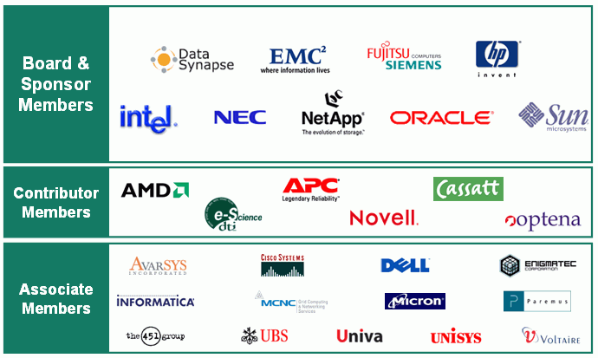
EGA Membership
Notes:
EGA Membership Growth
This chart lists the current membership of EGA in the various membership tiers. As mentioned the higher level your membership, the more say you have in the operations of the consortium.
EGA has grown substantially since we were formed in April 2004

Slide 6
Enterprise Grid Computing Landscape
Different priorities to traditional Grid community
  All about guarantees and not just best efforts
  Mission critical applications
Commercial and technical workload, inc. ALL of
  Traditional mixed workload, transactional (OLTP) and batch
  Data warehousing
  Web services and service oriented architectures
  Compute and I/O intensive
Key benefits - economies of scale
  Better performance, scaling, throughput and resilience
  Greater efficiency and agility
Widespread evaluation/pilots
  Benefits and value starting to be recognized
  Leading edge users seeking competitive advantage
Notes:
Enterprise Grid Computing Landscape
When we refer to Enterprise Grid Computing, basically we are talking about the same basic technology framework & network resources, but the difference is the technology is being used in public and private sector organizations for mission critical applications that drive businesses.
We are not talking about “wouldn’t it be great if we could capture all of these cycles and see what comes out at the end”, we’re talking about “it’s got to work because the nature of our organization depends on it”. Service levels must be high and they must be guaranteed.
We are talking about commercial and technical workloads vs. scientific applications. These workloads are compute intensive like in the academic and scientific world, but also with a more substantial I/O. Workloads are mixed and often have high transaction rates needed to run a business (General Ledgers, ERP, CRM for example). We are talking about batch applications that are extremely important for certain businesses, like portfolio analysis in the financial services sector. Increasingly we are also looking at things that are driven through the webservices and service oriented architectures.
Grid Computing in the Enterprise requires the same benefits as grid computing in the academic sense, economies of scale, performance and scaling, throughput and resilience, but requires additional efficiencies. In the enterprise space, people want to benefit by reducing cost, by providing greater services and they want the ability to bring things to market quickly, to deploy applications quickly, and to make sure those applications can grow to serve company’s business needs.

Slide 7
Barriers to Enterprise Grid Adoption
Reluctance to risk mission critical applications
Confusion
  What is Grid?
  How to apply grid in commercial data centers?
Immaturity
  Incomplete models
  Lack of stable standards
  Shortage of case studies and proven roadmaps
  Unproven interoperability between vendor products
Additional inhibitors
  Cultural attitudes toward exclusive ownership of IT assets
  Trust and accounting model issues
  Licensing and resource sharing concerns
Notes:
Barriers to Enterprise Grid Adoption
There were barriers to adoption of grid computing in the enterprise space a year ago when EGA launched and many still exist. The most significant barrier is the understandable reluctance of executives to risk their mission critical applications on technology which is perceived by some to still be at the bleeding edge.
There is also great confusion about exactly what grid technology is. Grid is a term that has been widely used and misapplied and especially on when described how it applies in a commercial data center environment. We also recognize there is an immaturity in the grid space and there are substantial gaps in the frameworks which have been brought forward up until now. Not that there is anything wrong what’s there, but we have some high level perspectives, such as GGFs OGSA, and we have some pretty low level kind of efforts coming out of organizations such as DMTF. We don’t have the glue that gets you from the high level 30,000 foot level down to the detail.
Finally there are some additional inhibitors, many of which are cultural in organization because Grid technology implies a re-concentration of resources and that leads to organizational implications. They also have to do with allocation of costs across organizations and licensing issues.
All of these barriers are things that EGA is currently addressing. We referred to them either generally or specifically when we formed EGA a year ago. EGA has made significant progress in some areas and in others there is still progress to be made.

Slide 8





EGA Role as Requirements Definer
Enterprise
Users*
Education
Reference Model
Profiles
Standards
Reference Architectures
Proof Points
Demonstrations
Requirements
Inhibitors To Adoption
*Enterprise users
  Commercial end users
  Public sector end users
  Systems integrators
  Solutions providers
Requirements, Model,
Glossary, Use Cases
Standards
EGA
Standard
Interfaces/APIs
Architectures
Vendors
Standards
Bodies
Compliant
Implementations,
Products
Requirements, Model,
Glossary, Use Cases
Notes:
Distributed Management Task Force
Storage Networking Industry Association
Global Grid Forum

Slide 9
Enterprise Grid Alliance Working Groups
Reference Model (Rev 1.5 released Mar 06)
  Common lexicon/taxonomy/model
  Use cases
Component Provisioning
  Requirements for provisioning (including use cases)
  Initially focused on servers
Data Provisioning (Problem Statement released Feb 06)
  Provisioning and management of data
Security (Req’s v1.0 released Jun 05)
  Requirements exclusive to grids
Utility Accounting
  Requirements for enabling utility billing and pricing
Notes:
EGA Working Groups
These are the 5 initial technical working groups we announced at the time EGA was launched last year. On May 10th we are going to be announcing the output of the first of these groups, the Reference Model working group. The rest of this presentation will cover the Reference Model in detail. In addition we continue to work on Component Provisioning, Data Provisioning, Security requirements that are unique and exclusive to the Grid space and utility accounting that is particularly focused on the chargeback and resource allocation aspect of grids.
The various working groups are targeted at what some of the top problem areas and applications where customers have needs that must be addressed in terms of inhibitors to the adoption of grid technology.
Component Provisioning: Customers want to be able to have rapid and automated provisioning so they can achieve control of these network based infrastructure environments. They need to be able to manage the lifecycle of components such as severs.
Data Provisioning: Customers want to be able to manage the lifecycle of things at a higher level of abstraction than they do today not just storage components, but data itself and manage the attributes of it.
Grid Security: If we look what a grid environment is, a networked distributed set of resources and applications and the services that run on them, technologies around things like virtualization. Components are going to be shared at any instant in time through virtualization technologies and shared through time through rapid re-provisioning and repurposing. That sharing and a number of other attributes of grids mean it is fundamentally different from the way people think of data centers of the past . It’s a lot more dynamic and the sharing means there are a lot more security requirements.
Utility Accounting: In grid environments people want to be able to set up a pay for buy infrastructure and sell services in a manner that is consistent with the value that they deliver. Utility is a big issue for users. They don’t want a big silo of their own, they want to be paying for what they use, when they use it.
Reference Model: It’s clear in the grid environment that what we needed internally and what seems to be missing externally is a clear understanding of what we mean by an enterprise grid. As opposed to a grid in a big internet based infrastructure.
We needed a small set of common terms, a taxonomy and model that would allow our various working groups to work consistently and describe things consistently and to share a common understanding. The initial goal wasn’t necessarily to drive the Reference Model externally. As it turns out this consistency is also needed externally. It became clear as we developed the model that there was a significant gap in understanding and in looking at what a grid is in a data center very specifically.
.

Slide 10
Industry Market Presence 2005
Participated in Industry Events
  GGF12, 13, 14, 15, 16, 17
  GridVIP Summits (Latin America, London, Chicago)
  SC ’05
  DMTF: Enterprise Management World
  GridWorld
Maintained regular announcements & market activity
  Managed global launches of 2 technical documents
  Conducted extensive press/analyst briefings
  Garnered good press coverage (over 55 articles)
Hosted Four User Forum Events

Slide 11
EGA reach was global
EGA activities were global
  EGA membership is comprised of global companies whose target markets for grid computing solutions are worldwide
APAC
  EGA Japan Regional Steering Committee (JRSC)
  Launched in July 2004
  Carried over to new OGF APAC Regional Steering Commitee
EMEA
  EGA EMEA Regional Steering Committee (ERSC)
  Launched September 2004
  Now OGF EMEA Regional Steering Committe

Slide 12
EGA Technical Program
Reference Model
  Providing a common context, glossary and taxonomy
  Use cases to frame requirements
  v1.0 released May 2005 (see later)
  V1.5 released March 2006 (see later)
Data Provisioning WG
  Chartered with identifying the requirements of data provisioning in Enterprise Grids resulting in the development of usage scenarios, requirements and functional specifications.
  Initial focus: simple bulk operations, with subsequent focus on incremental and fine-grained data operations.
  Problem Statement and Approach: Feb 2006
Notes:
EGA Roadmap: Technical Focus
Over the next 12 months, the Reference Model working group will be driving more detailed use cases. We will be mapping the model onto standard architectures and information models. What we’ve talked about informally today around mapping onto OGSA and into CIM we will be doing more formally.
If you look at a grid component it actually maps pretty neatly to a CIM managed element for example and many of the attributes of the GME map onto the capabilities of the OGSA architecture, but at the moment there is a disconnect between them. The EGA will actually bridge that gap and have an opportunity to provide consistency
The Component Provisioning working group is using the Reference Model to provide more detail provisioning use cases and requirements that we can use in our liaison relationships. For example, we intend to work with the DMTF Utility Computing working group, for example, and help feed them requirements so that their work on management tiers of services actually meets the needs of the enterprise and they have context for it.
The Data Provisioning working group is creating usage scenarios, mapping existing specifications onto them and working through our liaison relationship with SNIA to see what we can do there.
The next deliverable from EGA will most likely be a paper on grid security requirements from the Grid Security working group outlining how in an enterprise grid, security needs are subtly different in many ways. This should come out in the next 6 months.

Slide 13
EGA Technical Focus
Component Provisioning
  Mainly focused in provisioning of compute resources
  Provisioning use cases and requirements
  Work is on-going
Grid Security
  Completed the 1.0 version of the “Enterprise Grid Security Requirements” document.
  Focus will now be on real world solutions that can satisfy these grid security requirements
  Issues and resolutions and use cases
Notes:
EGA Roadmap: Technical Focus
Over the next 12 months, the Reference Model working group will be driving more detailed use cases. We will be mapping the model onto standard architectures and information models. What we’ve talked about informally today around mapping onto OGSA and into CIM we will be doing more formally.
If you look at a grid component it actually maps pretty neatly to a CIM managed element for example and many of the attributes of the GME map onto the capabilities of the OGSA architecture, but at the moment there is a disconnect between them. The EGA will actually bridge that gap and have an opportunity to provide consistency
The Component Provisioning working group is using the Reference Model to provide more detail provisioning use cases and requirements that we can use in our liaison relationships. For example, we intend to work with the DMTF Utility Computing working group, for example, and help feed them requirements so that their work on management tiers of services actually meets the needs of the enterprise and they have context for it.
The Data Provisioning working group is creating usage scenarios, mapping existing specifications onto them and working through our liaison relationship with SNIA to see what we can do there.
The next deliverable from EGA will most likely be a paper on grid security requirements from the Grid Security working group outlining how in an enterprise grid, security needs are subtly different in many ways. This should come out in the next 6 months.

Slide 14
EGA Technical Focus
Utility Accounting
  Focusing on tracking and measuring the grid for usage accounting, system management and capacity planning
  Using existing models and measurements as much as possible
  Building on top of reference model to define requirements for utility accounting
  Currently exploring requirements.
Notes:
EGA Roadmap: Technical Focus
Over the next 12 months, the Reference Model working group will be driving more detailed use cases. We will be mapping the model onto standard architectures and information models. What we’ve talked about informally today around mapping onto OGSA and into CIM we will be doing more formally.
If you look at a grid component it actually maps pretty neatly to a CIM managed element for example and many of the attributes of the GME map onto the capabilities of the OGSA architecture, but at the moment there is a disconnect between them. The EGA will actually bridge that gap and have an opportunity to provide consistency
The Component Provisioning working group is using the Reference Model to provide more detail provisioning use cases and requirements that we can use in our liaison relationships. For example, we intend to work with the DMTF Utility Computing working group, for example, and help feed them requirements so that their work on management tiers of services actually meets the needs of the enterprise and they have context for it.
The Data Provisioning working group is creating usage scenarios, mapping existing specifications onto them and working through our liaison relationship with SNIA to see what we can do there.
The next deliverable from EGA will most likely be a paper on grid security requirements from the Grid Security working group outlining how in an enterprise grid, security needs are subtly different in many ways. This should come out in the next 6 months.

Slide 15

Role of EGA Reference Model
Enterprise
Users
Education
Reference Model
Standards
Profiles
Reference Architectures
Proof Points
Demonstrations
General Requirements
Inhibitors To Adoption
Specific Use Cases
Specific Requirements
(eg Security, Component Provisioning etc.)
EGA
WG
EGA
Reference
Model
Specific Requirements
Requirements, Model,
Glossary, Use Cases,
Standards
Standard
Interfaces/APIs
Architectures
Vendors
Standards
Bodies
Validation
Compliant
Implementations,
Products
Requirements, Model,
Glossary, Use Cases
Notes:
Role of the EGA Reference Model
This is drill down on the previous diagram showing where the Reference Model plays.
It helps tease out requirements from Enterprise users, drive those in the form of use cases to vendors and the model and glossary provide a context for understanding those use cases
EGA will take back validations which are compliant with implementations which can impact the model. We expect the model to evolve as there are things the EGA will learn and things we will refine through time.
With regard to standards bodies, the same thing applies. We are driving a consistent glossary, driving use cases out and taking standards, APIs and architectures in and making sure we are consistent. If we are not, understanding why we aren’t and modifying the model so that we are consistent.
The extra point in the diagram is the other EGA working groups. The Reference Model working group has a function in a sense that it provides the generalized context, vocabulary and model that is leveraged by all the other EGA working groups. They take very specific requirements around security, component provisioning, etc and drive those requirements to the reference model. If there are issues with the model, they feed it back so we can modify the model. The other groups will provide the Reference Model with specific use cases which will be driven into to our requirements set and they drive specific requirements into other standards bodies through liaison relationships.
The other working groups will leverage the Reference Model, which is why it is the first deliverable. We needed it in order to allow our other working groups to have a common language and frame of reference for their work.

Slide 16
EGA Reference Model
An Industry first
  Fills an obvious gap; complementary to the existing body of work
Technology agnostic
  Makes no assumptions about implementation
  Avoids need to re-write/re-factor as technologies evolve
Vendor neutral
  20 participants from 14 EGA member organizations
Catalyst
  Reflection of the current understanding of Grid stakeholders
  Basis for collaboration with other industry bodies to ensure emerging standards meet enterprise requirements
Evolution
  Validate the model
  Solicit feedback From GGF, DMTF,SNIA, vendors, SI’s and end users
Notes:
Enterprise Grid Alliance Reference Model
We’ve now developed this Reference Model after a year of work. It’s an industry first in that it fills an obvious gap between the high level and quite abstract work of things like OGSA through the GGF. OGSA has a set of capabilities and needs and a set of architectural components but doesn’t enter into a design phase that shows specifically what a datacenter look like within this space.
At the bottom of the stack in some ways, but just as valuable, you have the very detailed work that is being done by CIM in the DMTF. But there is a lack of recognition at the moment of how you represent more abstract entities inside enterprise datacenters. Tiers of services, more abstract components like virtual machine monitors and managers, etc.
There is currently a gap that’s there and the Reference Model is about filling that gap through time. It works to tie back what we see as the high level abstract notions of things like OGSA back to the more concrete representations in things like CIM. Also CIM, for example, doesn’t capture things like a lifecycle which is where we wanted to fill a gap.
The Reference Model is technology agnostic so we make no assumptions about implementation as some of the other work out there. We wanted to create something that reflects, not only the future of technologies that implement grids, but also represent the infrastructure that people have in their datacenters today..
We could argue that today’s infrastructure is more or less a nascent grid. Grid is a natural evolution of network based computing that’s been going on for a long time. The really revolutionary thing about grid is less about the technologies and more a mindset about how you use those technologies and integrate them to deliver value.
We hope the technology agnostic nature of the Reference Model will allow us to avoid the need to rewrite and re-factor it as technologies evolve. This is a living, document and we do expect that through time it will evolve.
The Reference Model is vendor neutral. At least 20 participants from 14 EGA member companies actually participated in the work. This is substantial. If you look across many of the standard organizations, often there are only a few organizations involved in the direct authoring of documents.
We see the Reference Model as a catalyst. It’s a reflection of our current understanding of the grid stakeholders and we see it as a basis for collaboration with other industry bodies. Over the year we’ve learned a lot about where EGA can deliver value in this space. One of the areas, is around delivering and articulating requirements to the other standards bodies and vendors. Quite often they have been working in isolation without really tying back to the customer needs though detailed use cases. For example, GGF has a set of use cases, but they are not really focused on the Datacenter. There is a datacenter use case, but all the rest depict grand challenge type problems.
And even the work of DMTF doesn’t have that much context in terms of where people expect to use their model. That is a space we expect to fill by driving a consistent set of requirements into a number of bodies to ensure standard and products actually come together and genuinely meet the needs of the enterprise.
In terms of evolution, we expect to validate the model based on feedback from organizations such as GGF, DMTF and SNIA. We currently have relationships with these groups in various stages of maturity at the moment. We will also validate the model with vendors, Systems Integrators and Endusers. Our engagement with endusers is one of the things that makes EGA unique.

Slide 17
EGA Reference Model
Specific
  Enterprise data center grids
Sharp focus
  Provide shared context or framework for describing enterprise Grid customer requirements, technical problems and technical solutions inside and outside EGA
Simple
  Small set of simple objects, relationships and verbs describe highly complex data centers, their constituent parts and their life cycles
Notes:
EGA Reference Model
The Reference Model is very specific focused on Data Center Grids.
In it there is a concept of hierarchy that represents the hierarchies that enterprises typically have.
We don’t assume the implementation is necessarily hierarchical. It could be peer to peer much as GGF and OGSA assume, or it could be hierarchical in the way that many datacenters are driven today
The model has a sharp focus and is fairly simple. What we’ve tried to do is to create a model that allows you to understand the components in a datacenter in terms of a small set of objects, a small set of relationships, and a set of verbs that you use to drive those objects through their lifecycle.
We tie in the great complexity in terms of the logical representations in things like CIM with the more abstract things like GGF. We’ve made it a mapping that is relatively simple and intuitive once you’ve grasped the basics and that provides the context for describing our requirements.

Slide 18
EGA Reference Model
Glossary
  Defines a framework for classifying Grid resources/services together with their relationships and dependencies in a conceptual component architectural setting
Model
  Context for requirements, solutions and comparisons
  Vendor neutral
  Technology/implementation agnostic
  Describes existing data centers
  Does not assume a particular technology roadmap
Use cases
  Set of commercial enterprise community-centric use cases
  Consistent and relevant requirements for partner SDOs and all other enterprise Grid stakeholders
Notes:
EGA Reference Model
The Reference Model itself consists of a short glossary that makes sure we have consistency. It avoids terms that have a common understanding. EGA focused on terms that were most important. We are pragmatic in the sense that if someone else has a term that adequately describes what we are talking about and it has a reasonable uptake the EGA will use it.
The model itself builds on the glossary and creates a taxonomy. It provides a context for describing requirement solutions and comparing peoples products. It is vendor neutral and technology agnostic.
It describes an existing datacenter and is a logical representation of the type of datacenter that people have today
By same token one could use it to describe a datacenter that is completely realized with service oriented architectures and web services. The management components use web services as well. Its extensible in the sense that it doesn’t presuppose anything in terms of implementation and technology roadmap.
Finally the model ends up leveraged to drive a set of use cases. Evolution of these use cases will be the forward for the EGA Reference Model group. The model helps us drive and understand the use cases
We will use the use cases as our primary vehicle for driving requirements back into the other standards.

Slide 19
EGA Reference Model: Glossary
An enterprise Grid is a collection of interconnected (networked) Grid components under the control of a Grid Management Entity (GME)
Grid component - A super class of object including everything that is managed in an enterprise Grid
  Physical: servers, disks, switches, etc.
  Logical: services, applications, operating systems, load balancing software, tiers of services, etc.
Grid management entity - the logical aggregation that managed the enterprise Grid
  People
  Process
  Technology
Notes:
EGA Reference Model Glossary
EGA defines an Enterprise Grid as a set of interconnected or networked components under the control of a Grid Management Entity. In many ways it we take a very simplistic approach.
Networked Grid components could be anything ranging from a physical server, a disk, a switch, a remotely manageable power supply, terminal concentration and so forth…up through logical components all the way to a business application or service. So it could be a bookstore application, it could be CRM service, it could be an ERP service and any logical thing in between. It could be Operating Systems, there could be tiers of a service and things like that.
Each of those things has to be managed. Today the focus of management typically ends up in a low level componentry. To enable value to be derived from grid, that focus of management has to shift to the more abstract components, such as a service or a tier of a service and driving it through services level objectives and goals
We want to be able to describe those components and their relationships. We decided there is thing called a Grid Management Entity. The GME is just a bucket for everything that does management in a grid. It’s people, process and technology. A large part of that today is people and process, but over time the process will move from the people space into the technology space.

Slide 20
EGA Reference Model:
Representing Services As Graphs
More detailed drill down
E Bookstore
Persistent
Storage
Tier
Business
Logic
Tier
Presentation
Tier
Database
Cluster
Application
Server
Cluster
Web
Server
Farm
Database
Instance
Database
Instance
Application
Server
Instance
App Server
Load
Balancer_x0003__x0016__x0003__x0016_
App
Server
Firewall_x0003__x0016_
Web
Server
Instance
Web Server
Load
Balancer_x0003__x0016_
Web
Server
Firewall
Database
Storage
Database
Transaction
Log Storage
OS Container
Database
Media
OS Instance
Patches
OS Instance
OS Instance
OS Instance
Hardware
Partition
OS Media
Server
Boot
Disk/LUN
Server
Server
Load
Balancer_x0003__x0016__x0003__x0016_
Firewall_x0003__x0016_
Server
Load
Balancer_x0003__x0016_
Firewall
Notes:
EGA Reference Model: Representing Services as a Graph
This slide expresses the dependencies in the form of a graph. You can have multiple sets of graphs which represent an application or a service.
This graph of a bookstore allows you to see that the bookstore depends on Persistent Storage Tier, Business Logic Tier and Presentation Tier. You can drill down on each of those until you end up at physical components at the bottom.
So we are able to represent the complexity of a datacenter. This is one graph. A service could have several. This is one that could allow you do instantiation(?) There could be one for security, performance, availability and so forth.
And you can drill down to arbitrary complexity on the left. You can see the drill down. We capture all of the components that database instance happens to depend on.
These graphs become very interesting, because once you understand the relationships, applying a verb to something that’s high up in the graph becomes essentially the activity of just walking the graph and applying it to the each of the individual components to create an aggregated action.
It allows us to build up and represent complex things through a set of simple constructs.

Slide 21
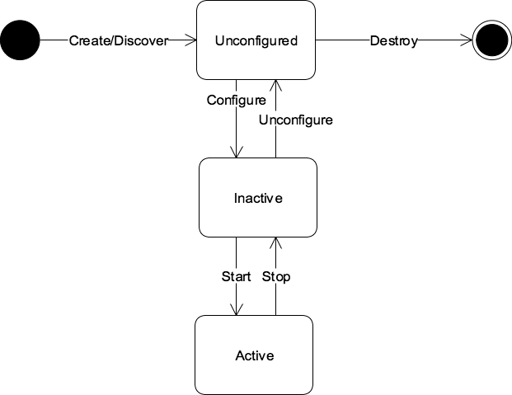
EGA Reference Model:
Grid Component Life Cycle
Provision
Decommission
Manage
Notes:
EGA Reference Model: Grid Component Lifecycle
Here we define a lifecycle of a component. Again, something that isn’t explicit in things like CIM at the moment although there is work being done on it. But we see that components get created or discovered, they get configured in some sense and they become inactive and they’re made active.
This can be applied to any component. The component we could be talking a bout could be a physical server. Obviously doing this to something abstract like this to a bookstore means implying this set of actions to everything underneath.
It doesn’t mean you have to do the tree all at once because obviously its possible with the technologies available today to actually stage things and leave them in partially configured states so you can be far more dynamic.
Again something that I-TIL has to recognize that many of the staging posts that people had in the lifecycle that are explicit in this diagram can actually be implicit.
You could have three operating systems for a given server that exists in your farm and just do a LUN(?) map to do the boot. You can be very agile. These technologies exist but are very rarely leveraged because they are considered unstable and hard to manage and that’s what we need to fix.

Slide 22
EGA Reference Model:
Role of Grid Management Entity
Vendor
Support
Enterprise
Bugs etc.
Notifications,
Patches etc.
Policy
Accounting &
Billing
GME
Other GMEs
Managing includes
Provisioning
Discovery
Configuration
Activation
Controlling
State
Performance
Scaling
Availability
Security
Decommissioning
Manage
Monitor
Monitoring includes
State
Performance
Scaling
Availability
Security
Accounting
Grid
Component
Notes:
EGA Reference Model: Role of Grid Management Entity
Here we talk about the lifecycle of special components.

Slide 23
EGA Reference Model:
GME and Grid Component Life Cycle
GME
Discover,
Control,
Monitor,
Notify
Notes:
EGA Reference Model: GME and Grid Component Life Cycle
We see that the GME in the big sense is a logical bucket that manages a grid component, in fact it manages all grid components. It’s a logical bucket and that means that its realized by people, processes and technology. There could be lots of products, we don’t assume a centralized physical version of a management thing.
It’s typically distributed amongst many management applications and services and could actually be distributed in the things you manage to some degree as well.
For example an availability cluster manages the lifecycle of some of the components under its control so it gets policy delegated from a bigger business entity and it actually manages a set of components on behalf of the thing that manages it.
The enterprise provides policy which gets implemented and used by the GME to manage the components, that monitors it.
You can see how the GME interacts during the lifecycle. It actually manages the lifecycle of all these components.
The thing that’s key is it interacts with an active component to some greater or lesser degree in an automated fashion. So you have to make something logically manageable in the grid to be able to automate the technology.
The underlying thing has to be in active state so that it can actually manipulate the lifecycle of the things that layer on top of it.

Slide 24
EGA Reference Model:
GME and Service Level Management
Vendor
Support
Enterprise
Bugs etc.
Notifications,
Patches etc.
Policy
Accounting &
Billing
GME
Assigns/Provisions
Reconciled
Resources
(other
Grid Components)
Metrics
Manage
Monitor
Grid
Component
Consumed
Generates
Notes:
EGA Reference Model: GME and Service Level Management
This also fits in with service level management so you can see how it fits in with provisioning resources

Slide 25
EGA Reference Model:
GME Delegated Policy and SLM
Vendor
Support
Enterprise
Bugs etc.
Notifications
Patches etc.
Business
Policy
Accounting
& Billing
Logical
GME
Data Center
GME
Component
Derived
Policy
Accounting
& Billing
Provision
Bookstore
GME
Component
Manage
Electronic
Bookstore
Grid
Component
Monitor
Derived
Policy
Accounting
& Billing
Provision
Database
Cluster
GME
Component
Manage
Database
Cluster
Grid
Component
Application Server
Cluster
Grid
Component
Monitor
Notes:
EGA Reference Model: GME Delegated Policy and SLM
You can now see when we take these things together we have a graph outside and we have a graph inside. For every managed component there is a logical management component. Whether this exists as a discrete realization or not is irrelevant.
You can see now that the enterprise sent down business policy, results in derived policy for a given service and more derived policies for the database and so forth.
If you look at OGSA for example from GGF, these things are talked about in terms of capabilities, but there isn’t a design element. The EGA Reference Model is driving the design element
When you look at things this way, this then allows you to map existing products into this space. For example, with a database cluster one could say 9i or 10g would fit in there, capturing both some of the GME element and the actual grid component that sits outside.
It allows us to represent and compare all of the things we have.

Slide 26
EGA Reference Model:
GME Functional Breakdown
Vendor
Support
Enterprise
Bugs etc.
Policy
Accounting
& Billing
Provisioning/-
Decommissioning_x0016_
Notifications
Patches etc.
Business
Policy
Accounting
& Billing
Service
Level
Management
Logical
GME
Data Center
GME
Component
Security _x0003__x0016_
Orchestration
Control_x0003__x0016_
Derived
Policy
Accounting
& Billing
Provision
Performance
Management
Availability
Management _x0003__x0016_
Bookstore
GME
Component
Manage
Electronic
Bookstore
Grid
Component
Monitor
Monitor
Derived
Policy
Accounting
& Billing
Provision
Database
Cluster
GME
Component
Manage
Database
Cluster
Grid
Component
Application Server
Cluster
Grid
Component
Monitor
Notes:
EGA Reference Model: GME Functional Breakdown
The GME can be broken down functionally. These are fairly commonly accepted breakdowns. There is a policy function in terms of taking policy translating it for internal use and then providing derived policy to anything that sits underneath it in the stack
This actual breakdown actually applies to any GME component or to the GME as a whole.
There’s accounting and billing where you can imagine the upstream one would be sending up aggregated information, it would collect metrics from down below and it would get monitoring information from the thing that actually manages and reconciling value with cost
There’s a service level management aspect around performance, availability and security. And then there is control monitoring, provisioning, de-commissioning, for example.
We expect to drill down on these in more detail as we go through time.

Slide 27
Scenarios & Use Cases
Scenario
  The storyboard, e.g. line of biz VP walks into IT VP’s office and says “I need this new service deployed”
Use Case
  Enumerated set of steps required to realize the scenario
  Sequence diagrams (UML)
  Detailed
  Leverage EGA reference model
  Describes today’s process (NOT the desired state) so as to identify major pain points and their context
  Goal
    Automate process by replacing actors with software/services
    Identifies appropriate services and their functionality

Slide 28
Use Cases
Key Enterprise Grid Technology Areas
  Virtualization
  Abstraction
  Automation
Automation
  Moving Process From Human To Machine Domain
Enterprises Are Built On Process
  ITIL, eTOM, COBIT, Ad Hoc
Use Cases
  Proven mechanism to aid problem decomposition
  Allow us to enumerate and capture problem and context, including process
  Leverage Reference Model - map processes to model

Slide 29
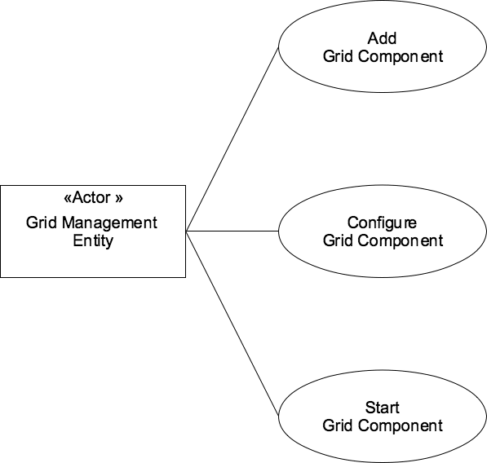
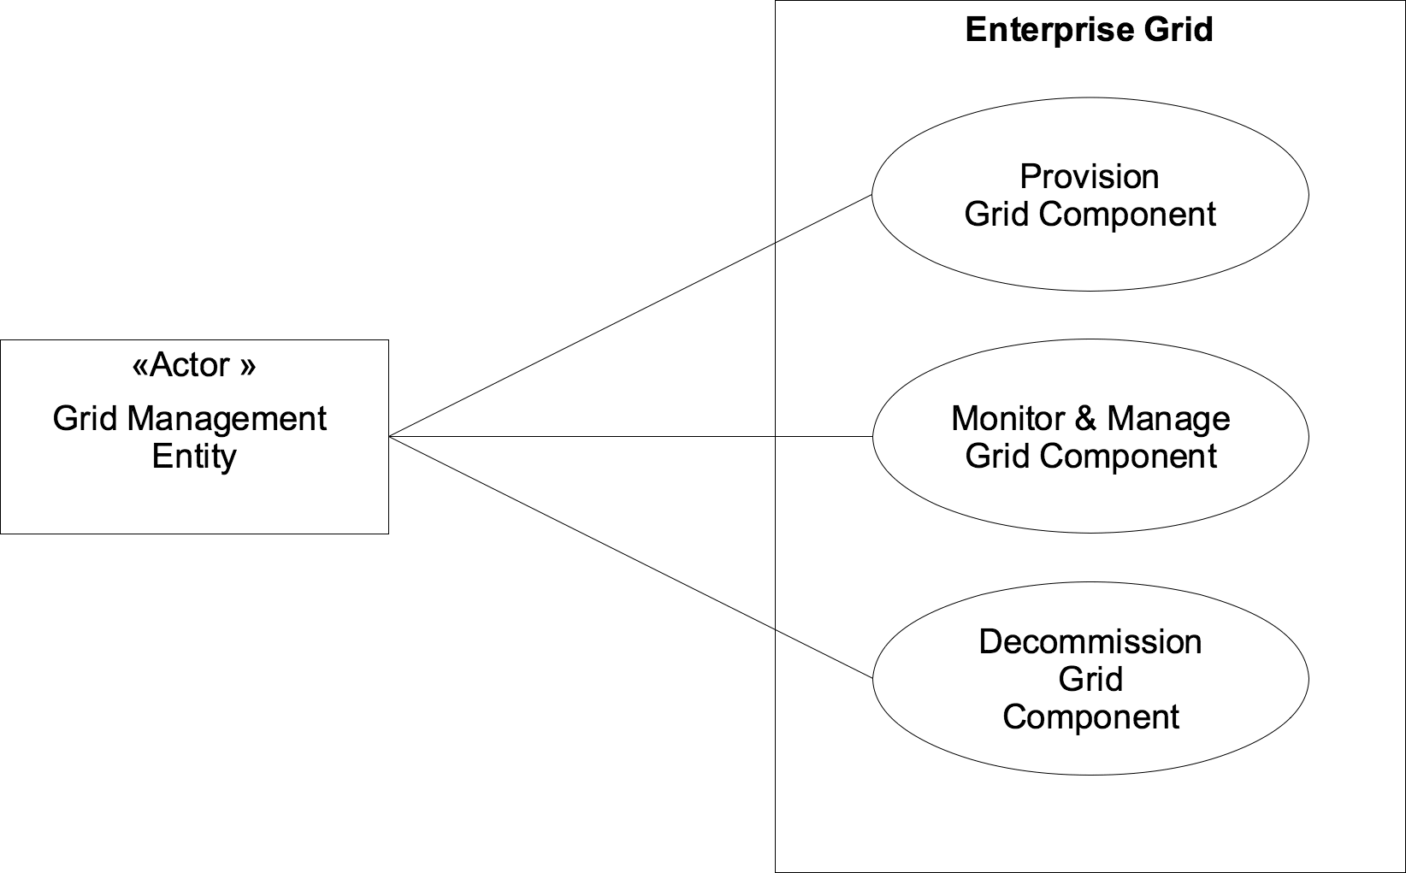
EGA Reference Model: Use Case - Managing Grid Component Life Cycle

Slide 30
Use Case Format
Title
Summary
Dependencies
Actors
Stakeholders
Pre-Conditions
Initiation Of Use Case
Flows
  Basic, Alternate, Exceptional
Success Criteria
Post Conditions

Slide 31
Provisioning By Walking The DAG
ApplyVerb {ProvisionGridComponent}
Database
Instance
Database
Media
Database
Binary Storage
OS Container
Database
Transaction
Log Storage
Database
Storage
OS Instance
OS
Patches
OS Media
Server
Boot
Disk/LUN

Slide 32
Provisioning By Walking The DAG
ApplyVerb {ProvisionGridComponent}
Database
Instance
Database
Media
1
Database
Binary Storage
2
OS Container
3
Database
Transaction
Log Storage
4
Database
Storage
5
OS Instance
3.1
OS
Patches
3.2
From leaf nodes up
OS Media
3.1.1
Server
3.1.2
Boot Disk/LUN
3.1.3
From left to right

Slide 33
EGA Use Case Delivery
Pragmatic
  Driven by high priority data center problems
  Context for other EGA working groups
  Basis for collaboration with other bodies, e.g. GGF, DMTF, SNIA
v1.0 - Released May 2005
  EGA Reference Model
  Template use case
V1.5 - Released May 2006
  Focus on provisioning
  Bottom up
  50+ detailed use cases
  Validation via User Forums/Group
v Next++
  Service Level Management use cases
  Top down

Slide 34
2nd EGA Technical Announcement
Enterprise Grid Security Requirements v1.0 document was launched WW on Monday, July 25
The second technical deliverable to be introduced to the public
Document Covers Enterprise Grid Security:
  Threats/Risks
  Use cases
  Requirements

Slide 35
Enterprise Grid Security
Why are we talking about security?
  Often a barrier to adoption for new enabling technologies
  Should not be an afterthought
Focus on unique aspects of enterprise grid
  Lots of existing material for general enterprise security
  Different than traditional grid community focus
Key characteristics
  Sharing
  Grid Management Entity (GME)
  Grid component lifecycle
Notes:
So why are we talking about security? There’s a pattern that repeats itself when new enabling IT technologies come out. Typically, security is not factored in at the get go and often left as an exercise to be done later. This often results in these new technologies not being adopted right away because security (or lack there of) becomes an obstacle preventing widespread adoption (especially by enterprises that are running mission critical applications and really care about risks and security). [Examples include web services, 802.11 Wi-Fi, etc.] So the EGA made a very deliberate decision over a year ago to make security one of the initial focus areas (and hence a working group). And it’s no accident that this is the first working group following on the heels of the base EGA reference model announcement – so we do send the message that security is important and here are the issues.
Clearly, there’s already a lot of material out there on general enterprise security – and we didn’t want to re-invent the wheel. So we’ve had a very sharp focus on the *unique* security issues arising from an enterprise grid. We also deliberately scope this (for now) to a single enterprise data center and so are not focused on global grids that can span many different enterprise or other organizations.
One of the main characteristics of an enterprise grid is the “sharing” of grid resources. This sharing can be in a single point in time – where a resource (e.g. O/S, server, cluster) is running several workloads. Sharing can happen through time when a grid component gets repurposed. The EGA Reference Model actually helps capture this focusing the notion of a “Grid Management Entity” (which is needed to manage this “sharing”). Also, by looking at the lifecycle of any given grid component (where it may be frequently reprovisioned) we’re talking about the sharing across time.
The sharing - which yields utilization benefits and agility benefits is perhaps the key difference between a traditional data center and an enterprise grid. The former is silo-ed, the latter is a shared fabric. And this sharing will place new, or emphasize existing security requirements.

Slide 36
Enterprise Grid Security:
Threats & Risks
Access control attacks
Defeating audit and accounting
Denial of Service (DoS)
Malicious code/malware
Object reuse
Masquerading attacks
Sniffers
Physical security
Social engineering
Notes:
When we talk about information security, a key step in the process is to understand the threats and risks. So we looked at the following categories. You’ll notice that these are not new terms but terms that should be very familiar to the security practitioner. What we did was to look at the unique aspects of these in an enterprise grid environment. We looked at this from a “hackers’ perspective”, if you will. Some examples are (without stepping through each and every threat and risk we identify in our document):
How is access control manifested in an enterprise grid environment and how can this be compromised?
Auditing and accounting are particularly important in an enterprise grid environment. How can this be defeated?
Denial of Service can be very bad for a business. In an enterprise grid environment – one has to look at pieces like the Grid Management Entity. Does this become a new DoS vulnerability point?
Whenever there’s new technology or new programming languages or environments, there’s always a corresponding class of new types of malicious code or malware. In an enterprise grid, we’re not really necessarily talking about new technology. But one needs to be cognizant of how malicious code may try to take advantage of the unique aspects of an enterprise grid (the GME, grid components being frequently reprovisioned, etc)
Object reuse refers to sensitive data or information left behind or not being properly cleaned up when something is decommissioned or repurposed. Clearly this is an important consideration in an enterprise grid environment.
Masquerading attacks refer to entities impersonating someone legitimate. With a GME or an enterprise grid, there may be some potential new ways to masquerade.
Sniffers typically refer to an existing threat in network security. The same principles apply to an enterprise grid and there may potentially be new opportunities to sniff.
In order to take a holistic security perspective, one should no ignore basic real world issues like physical security. For example, if a data center was previously siloed into separate rooms with different access privileges, and with an enterprise grid the physical layout changes – one can’t forget about physical security.
Social engineering attacks often succeed when new technology or processes are introduced. In this regard, an enterprise grid is no different and users and admins need to be trained to protect against social engineering attacks.

Slide 37
Enterprise Grid Security:
Use Cases
Provision a grid component
  Trust relationship
  Secure configuration and start
Monitor and manage a grid component
Decommission a grid component
  Secure stop and reuse
Operation use cases
  User/service security events
  Workload security events
Notes:
In addition to threats and risks, we took a look in more detail at the security specific aspects of the use cases defined in the EGA Reference Model. The first three bullets are the major “buckets” of use cases in the lifecycle of a grid component. There are also ongoing uses cases that are orthogonal to the lifecycle of any given grid component. Our document spells out many of the security issues here. For example:
Provisioning a grid component: “trust relationships” are clearly important between all the entities in an enterprise grid (GME, grid components, apps/services, users, admins). Securely configuring and starting grid components is also important.
Monitoring and managing a grid component is like managing any type of enterprise IT infrastructure. With an enterprise grid, and depending how automated and centralized a GME is – this may be easier
Decommissioning a grid component (securely) is something that needs special attention because grid components may be reprovisioned right away by another application/service and be used by a different set of users. (Hence the importance of, for example, of cleanly scrubbing all sensitive data and information)
Ongoing security events are much like a regular data center. Unique “grid” aspects include the role of the GME and how it manages these events. Also, the nature of a workload that gets dynamically farmed out to a set of grid resources implies some security considerations.

Slide 38
Enterprise Grid Security:
Requirements
Confidentiality, Integrity, Availability
  GME, grid components, applications/services
Identification
  GME, grid components, applications/services
Authentication, Authorization, Auditing
Separation of duties, least privilege
  Ex: “grid admin”
Defense in depth
  Preserved, even if it’s logically (ex: DMZ)
Fail secure
  More important with frequent reprovisioning
Notes:
And now to the meat of the document. These are a basic set of security requirements that have unique aspects with respect to an enterprise grid. This is not meant to be an all inclusive list. And it’s also not an all or nothing mandatory list of requirements. Each organization needs to make the business decision as to which one of these are actual “requirements” and mandatory based on risk analysis and cost/benefit ratios.
Again, we’re not introducing any new terms – these should all be familiar to the security practitioner. In our document, we spell out some of the unique aspects of these to an enterprise grid environment. Some examples include:
The CIA triad – the 3 pillars of information security. With an enterprise grid – these need to be applied to the GME and each grid component and any unique interactions between them and users/admins.
Identity management has had a lot of attention these last few years and the same principles and requirements apply to an enterprise grid environment. In particular, the GME (as it becomes more automated) and each grid component needs to be tracked as unique identities. So do the applications and services that are running on the enterprise grid. And of course, users and admins as well.
AAA are basic security requirements anywhere. The GME plays a role as the container for AAA services
Separation of duties and least privilege are security are basic security principles. In an enterprise grid environment, this may lead to defining new roles, such as a “grid admin.”
Security should always be layered. So even if we’re moving to a more networked and shared pool environment, these same principles should be preserved. For example, the notion of a “DMZ” does not go away – it can still be implemented logically.
Failing securely is another fundamental tenet of information security. In an enterprise grid, we don’t necessarily expect more failures but since we are talking about a shared environment – this is an important requirement.

Slide 39
Enterprise Grid Security:
Requirements
Grid Lifecycle Security
  Secure packaging
  Secure update
  Secure archival
  Secure reuse
Interoperable security
Secure isolation
  Physical, electrical, logical
Trust relationships
  GME, grid components, applications/services, users, admins
Notes:
There are various requirements related to the lifecycle of grid components…
We also expect a heterogeneous mix of grid components, coming from multiple vendors and solution providers. Hence interoperable security is key.
Secure isolation (using the DMZ example again), should be preserved. This can be a mixture of physical, electrical, and logical separation based on a given organizations security policy
We mentioned trust relationships before. This is a requirement that will depend on some underlying security mechanisms to support this. For example, using X.509 certificates for authentication or digital signatures.

Slide 40
Enterprise Grid Security:
Benefits
Availability
Centralized security management
  Consistent and verifiable security configurations
  Rapid response to security events
Notes:
So far, everything that has been mentioned has been from the perspective of what can go wrong (with threats and risks) and how to meet basic requirements. As it turns out, an enterprise grid can have some security benefits over a non-grid, silo-ed environment.
The obvious one is in the area of availability. Assuming an environment that is managed and configured well, availability can be better not only in terms of uptime (where the grid can deal with any grid component failure gracefully), but also in terms of availability of processing power, storage, and network bandwidth. So availability is one of the expected benefits of an enterprise grid
Like the case for centralized identity management (where there is one or fewer points of administration leading to improved security by allowing better data consistency, stronger administration and policy, etc) – the GME also offers the possibility of better security (as it gets more automated from today’s mixture of people, process, technology)
And there will likely be other security benefits as organizations move to an enterprise grid. This movement overlaps with the current move to data center standardization and so there are security benefits there (ex: easier to deal with security patches)

Slide 41
Enterprise Grid Data Provisioning
Data Provisioning WG – EGA
Alan Yoder, Ph.D., chair
Network Appliance, Inc.

Slide 42
Data Provisioning WG
Chair - Alan Yoder, Network Appliance
Co-chair - Curt Kolovson, HP
Members - Oracle, FSC, EMC (former)

Slide 43
DPWG work history
Preliminary work on API
Evaluation of GGF use cases
Data movement requirements
- delivered to SNIA in May 2005
Requirements analysis effort

Slide 44
Final project -- 2005
Enterprise Grid Data and Storage Provisioning Problem Statement and Approach
  Problem statement – it’s big!
  Approach
    Divide and conquer
    Use cases for each area
  Elements of Storage Management and SRM
  Higher level elements as well
    Need to manage data as well as storage

Slide 45
GME
Grid Management Entity (per Reference Model)
Intermediary between applications and storage
Involved at several levels
Many steps to what may look like an atomic operation

Slide 46
GME example
“Give me a 4 TB container with such-and-such an SLA”
  Find appropriately sized storage container
  Secure container so only requester has data access
  Set up switching between requester and storage
  Set up a VLAN or FC mask
  Engage any cryptographic security mechanisms
  Engage OR, DR, backup systems
  Hand client back a mount point

Slide 47
Focus areas
Asset Discovery, Asset Management and Topology
Provisioning and Capacity Management
Root Cause Analysis
Data Copy, Data Movement and Backup
Policy Management and Quotas
Monitoring, Auditing and Alert Management
Content provisioning and Discovery
Billing and Chargeback
Device
Management
Data
Management

Slide 48
Drilldown example
Asset Discovery and Management
  Discovery
  Commissioning and decommissioning
  Capabilities as related to SLOs
  Chargeback units and quantities
  Security parameters related to access and use
  Data access protocol support
  Size and availability data (allocation statistics)
  Topology

Slide 49
Drilldown example (cont.)
Asset Discovery and Management
  Discovery
    Server type (Storage, Switch)
    In-band access type (NFS, CIFS, HTTP,
    FTP, WebDAV, FC, IP) and addresses
    Management protocols and addresses
    Admin contact address and method

Slide 50
Drilldown example (cont.)
Asset Discovery and Management
  Discovery
  Commissioning and decommissioning
    “Indication” support for new instances
    Retirement scheduling
    Prevent decommissioning during use

Slide 51
Drilldown example (cont.)
Asset Discovery and Management
  Discovery
  Commissioning and decommissioning
  Capabilities as related to SLOs
    Available capacity
    Transport protocols
    RPO and RTO
    Availability
    Chargeback parameters
    Projected lifetime
    Data copy capabilities
    Data security capabilities

Slide 52
Future Direction
Purpose of paper was to get feedback on direction from Alliance partners
SNIA positive
  SMI-S is the only storage management standard currently in place
  Prior successful interaction
  SNIA Grid Taskforce engaged

Slide 53
Future direction
Purpose of paper is to get feedback on direction from Alliance partners
SNIA positive
SMI-S is the only storage management standard currently in place
Prior successful interaction
SNIA Grid Taskforce engaged
GGF TBD

Slide 54
Future Direction (cont.)
Requirements gathering is a marketing-focused activity
  Difficult to get engineers engaged
  Possibly need a different kind of group

Slide 55
Efforts going forward

Slide 56
EGA Efforts Going Forward
That’s what we’re here to discuss
Additional Reference Model & Use Cases documents nearly ready to release
  Finish infrastructure use cases
  Bare metal through app server tier
Reconcile Reference Model with OGSA
  Discuss Tuesday 4:30
Move EGA work forward as separate groups, or merge efforts with existing working groups
Notes:
EGA Roadmap: Marketing Focus
When the EGA was formed, people asked if EGA is really just a marketing organization or a technical organization. Our answer was it’s 60/40 and we’re not sure which is 60 and which is 40. What we are all about is to bootstrap and grow a market
A lot of that has to do with proselytizing and spreading the word about grid computing and its capabilities in the enterprise. We perceive ourselves as having a focused mission in that we are specifically looking at the enterprise and how to apply grid technologies specifically in that space.
We have a marketing arm that drives our marketing efforts. Their charter for the year ahead is to establish EGA as the thought leader for grid computing in the enterprise. To educate people and make them aware of grid technology and how it plays in the enterprise environment. And to keep our organization robust by bring in new organizations. They do that through various marketing outreach programs.

Slide 57
Discussion

